Slide 1
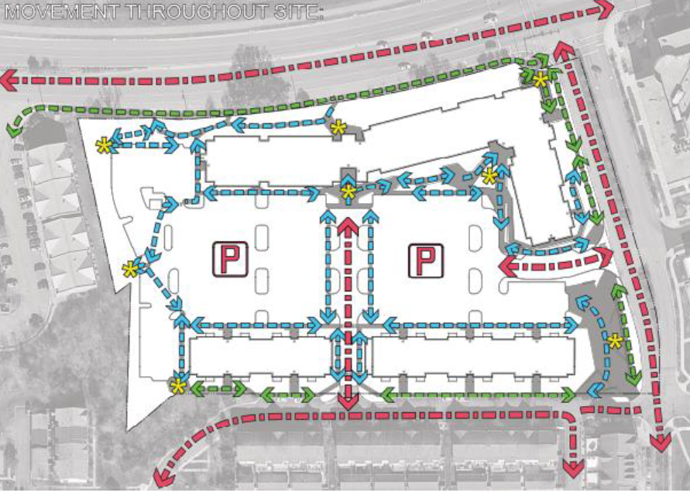
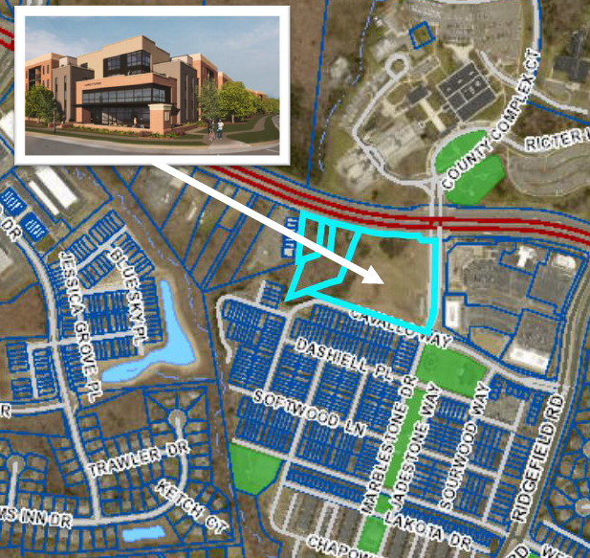
COMMUNITY CALL FOR ACTION – STAND UP AGAINST SWEETSPIRE!
WE NEED YOUR HELP:
Your presence is NEEDED to support your community. We NEED commercial retail, not more residents
SAVE THE DATE: MAY 7, 2025
TIME: 7:00 PM
LOCATION: 1 COUNTY COMPLEX COURT
WOODBRIDGE, VA 22192
(Just Across the Street from the Community)
Increased Traffic and Congestion
Towing Services and Increased HOA Dues
Overcrowded Schools/Buses
Inadequate Parking Accommodations
Strain on Existing Facilities/Infrastructure/Services
Loss of Community Character

