Slide 1
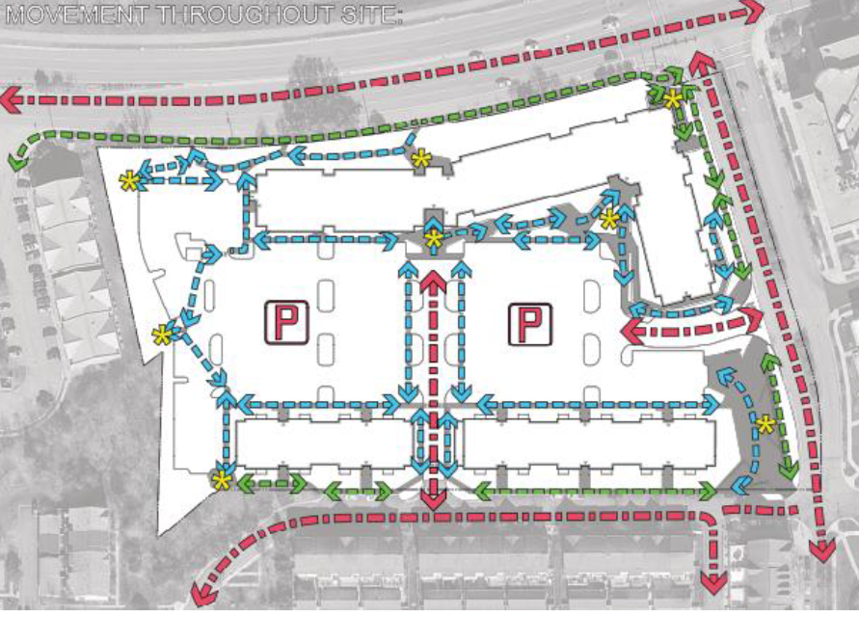
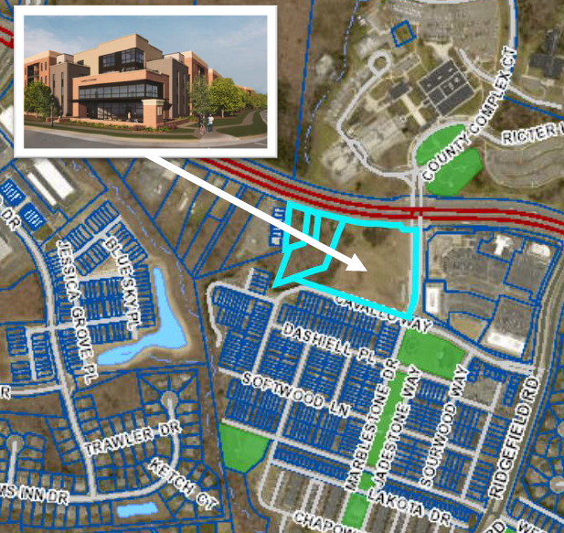
COMMUNITY CALL FOR ACTION – STAND UP AGAINST SWEETSPIRE!
WE NEED YOUR HELP:
Your presence is NEEDED to support your community
SAVE THE DATE: MAY 7, 2025
TIME: 7:00 PM
LOCATION: 1 COUNTY COMPLEX COURT
WOODBRIDGE, VA 22192
(just Across the Street from the Community)
Increased Traffic and Congestion
Towing Services and Increased HOA Dues
Overcrowded Schools
Poor Parking Accommodations
Strain on Existing Facilities and Infrastructure
Loss of Community Character

