Slide 1
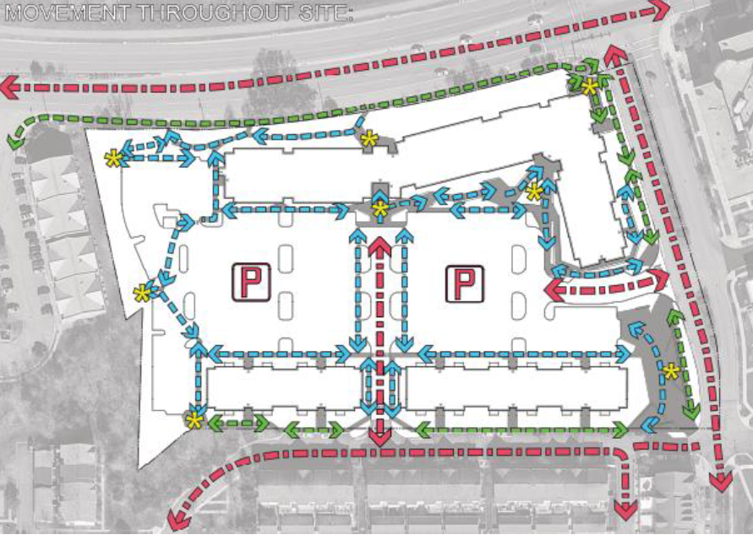
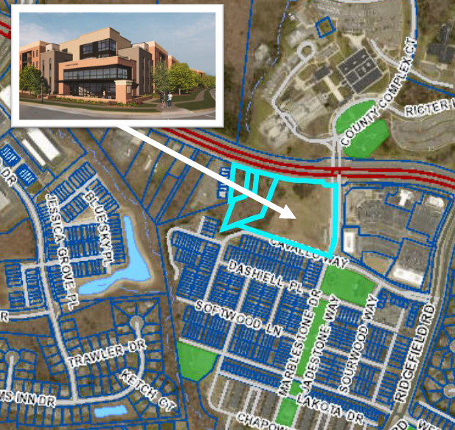
COMMUNITY CALL FOR ACTION – STAND UP AGAINST SWEETSPIRE!
Potential Decrease in Property Value
Increased Traffic and Congestion
Towing Services and Increased HOA Dues
Overcrowded Schools
Poor Parking Accommodations
Strain on Existing Facilities and Infrastructure
Loss of Community Character
SAVE THE DATE: SEPTEMBER 13, 2023
TIME: 7:00 PM
LOCATION: 1 COUNTY COMPLEX COURT
WOODBRIDGE, VA 22192
(just Across the Street from the Community)

